Slide 1
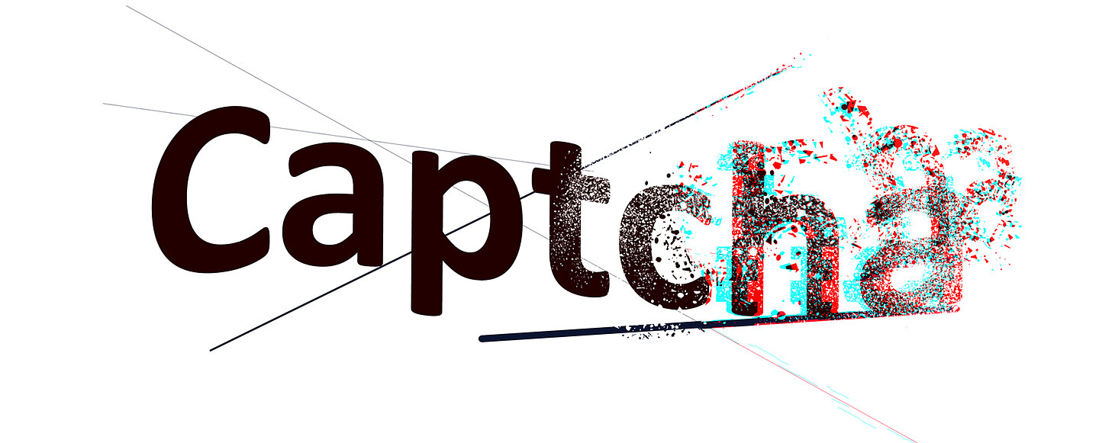
CAPTCHA RECOGNITION
CET023 (22FMBFA05) Group 7:​ https://youtu.be/wsuyGSoIU_k
Sim Fang Rui (Matriculation Number: K2220352C)​
Syahri Ikram (Matriculation Number: K2220348J)
Wu Ning (Matriculation Number: K2220372K)​
Yap Wei Jer Terence (Matriculation Number: K2220349F)​

Slide 2
AGENDA
Slide 3 - 4
1. Objective
Slide 5 - 6
2. About The Data
Slide 7 - 12
3. Modelling
Slide 13 - 16
4. Evaluation and Insights
Slide 17
5. Future Scope

Slide 3
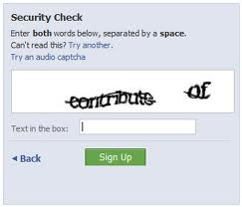

OBJECTIVE
Differentiate machine and human

Slide 4

OBJECTIVE
To use Machine Learning to decipher and beat the original text-based CAPTCHA codes.

Slide 5
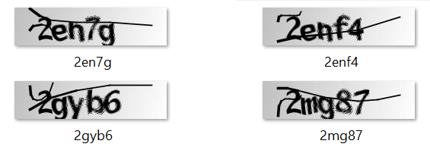
ABOUT THE DATA
Kaggle dataset titled “CAPTCHA Images”.
Sample data:
Collection of 1070 CAPTCHA 200 X 50 PNG and JPG images.
Series of 5 letter strings that consist of alphanumeric characters that have noise applied to them like blurs, lines, and distortions.
Kaggle.com. 2018. CAPTCHA Images. [online] Available at: https://www.kaggle.com/fournierp/captcha-version-2-images

Slide 6
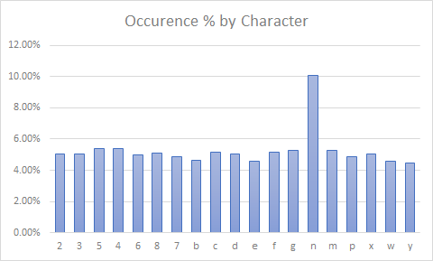
DESCRIPTIVE STATISTICS
Sample size
1070 CAPTCHA
Types of characters in sample
20
Total character count
5350
Median occurrence % per character
5.07%
Approximately equal split in occurrence of each character

Slide 7
DATA PRE-PROCESSING
Normalization
One-hot Encoding
To standardize to [0,1]
To re-shape image labels

Slide 8
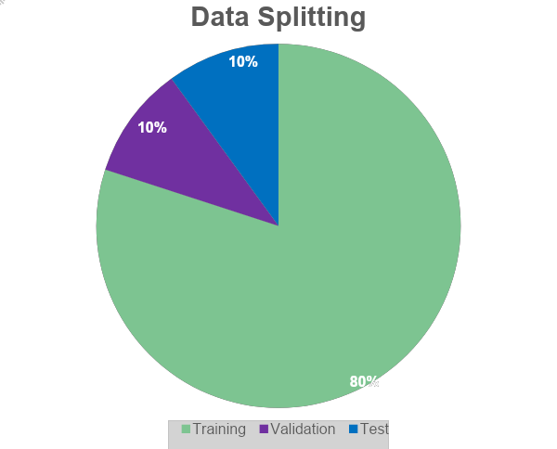
TRAIN – VALIDATION – TEST SPLIT
Notes:
Parameters: Neurons in MLP layer, dropout rate, Stacks of layer, Epoch

Slide 9
MODELLING
Images have high dimensionality (as each pixel is considered as a feature)
CNN is effective for image classification as the concept of dimensionality reduction suits the huge number of parameters in an image without losing on the quality of models.
Trained to identify patterns in any image.
CNN

Slide 10
MODELLING – DESIGN PRINCIPLES
Those inspired by successful models like RestNet/ VGG16:
Narrow and deep
Small filter size (e.g. 3x3)
Number of filters doubles in successive (groups of) layers
Use “same” padding to properly utilize information on corners and edges of image
All layers, except for the final softmax layer, uses Relu
Other good practices:
“Categorical cross-entropy” loss function for classification tasks
Use dropout layers for regularization
Optimizer “Adam” for dynamic learning rate
Notes:
Report

Slide 11
Input
Input
Model 1
3x3 Convolution – 16
Model 2
3x3 Convolution – 16
DESIGN OF MODEL
3x3 Convolution – 16
3x3 Convolution – 16
MaxPool - 2,2
MaxPool - 2,2
Dropout - 0.2
Dropout - 0.2
3x3 Convolution – 32
3x3 Convolution – 32
3x3 Convolution – 32
3x3 Convolution – 32
MaxPool - 2,2
MaxPool - 2,2
Droput – 0.2
Droput – 0.2
3x3 Convolution – 64
3x3 Convolution – 64
3x3 Convolution – 64
3x3 Convolution – 64
MaxPool – 2,2
MaxPool – 2,2
Dropout – 0.2
Dropout – 0.2
Flatten
Flatten
FC 1 Dense 64 Dropout 0.2 Dense 36
FC 2 Dense 64 Dropout 0.2 Dense 36
…
FC 5 Dense 64 Dropout 0.2 Dense 36
FC 1 Dense 128 Dropout 0.2 Dense 36
FC 2 Dense 128 Dropout 0.2 Dense 36
…
FC 5 Dense 128 Dropout 0.2 Dense 36
Character #1
Character #2
Character #5
Character #1
Character #2
Character #5

Slide 12
Input
Input
Model 3
3x3 Convolution – 16
Model 4
3x3 Convolution – 16
DESIGN OF MODEL
3x3 Convolution – 16
3x3 Convolution – 16
MaxPool - 2,2
MaxPool - 2,2
Dropout - 0.2
Dropout - 0.2
3x3 Convolution – 32
3x3 Convolution – 32
3x3 Convolution – 32
MaxPool - 2,2
3x3 Convolution – 32
Droput – 0.3
MaxPool - 2,2
3x3 Convolution – 64
Droput – 0.3
3x3 Convolution – 64
3x3 Convolution – 64
MaxPool – 2,2
Dropout – 0.4
3x3 Convolution – 64
3x3 Convolution – 128
MaxPool – 2,2
3x3 Convolution – 128
Dropout – 0.4
MaxPool – 2,2
Flatten
Dropout – 0.5
Flatten
FC 1 Dense 64 Dropout 0.4 Dense 36
FC 2 Dense 64 Dropout 0.4 Dense 36
…
FC 5 Dense 64 Dropout 0.4 Dense 36
FC 1 Dense 128 Dropout 0.5 Dense 36
FC 2 Dense 128 Dropout 0.5 Dense 36
FC 5 Dense 128 Dropout 0.5 Dense 36
…
Character #1
Character #2
Character #5
Character #1
Character #2
Character #5

Slide 13
PERFORMANCE EVALUATION
Individual Character Accuracy
Correct Character Predictions
Total Character Count
Correct 5-character Set Predictions
Full CAPTCHA Accuracy
Total 5-character Set Count
Notes:
There are two indicators that we used to evaluate models’ performance: prediction accuracy on individual character and that on the full CAPTCHA.

Slide 14
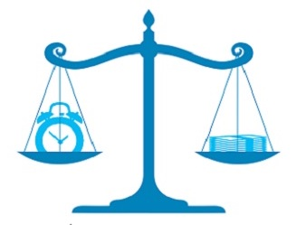
PERFORMANCE EVALUATION
Individual Character Accuracy
80%
60%
Full CAPTCHA Accuracy
60%
20%
Trade-off needed given the use case

Slide 15
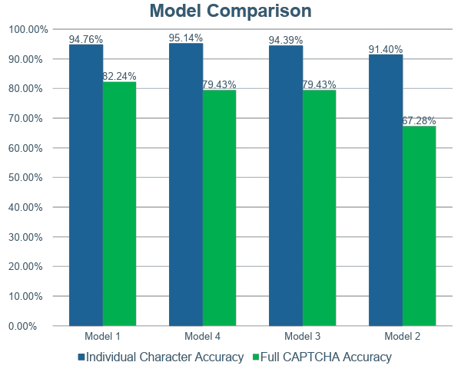
PERFORMANCE EVALUATION

Slide 16

OTHER INSIGHTS
The “m” and “n” pair accounts for 28% of all errors observed during testing.
(The next highest, “3” vs “7” accounted for only 5%)

Slide 17


FUTURE SCOPE
IMPROVING ACCURACY OF PREDICTING EXISTING DATASET.
DEVELOP NEW MODELS TO CATER FOR MORE COMPLEX CAPTCHAS.
Notes:
Mention about business implication part 7.

Slide 18
CAPTCHA RECOGNITION

